Slide 1

Introduction to LightBurn software
Instructor: Whoever
Version 2021-07-14

Slide 2
Agenda
Tour of the LightBurn Interface.
LightBurn as part of the laser workflow
Real-world example – pencil box
Working with Images
Configuring LightBurn on your own computer

Slide 3
What is LightBurn?
LightBurn is the software ETA uses to control our new lasers.
IMPORT shapes and arrange them into your project
Vector Files: .ai, .pdf, .sc, dxf, .hpgl, .plt, .rd, .scpro, .svg, .lmrn
Image files: .bpm, .jpg, .jpeg, .png, .gif, .tif, .tiff, .tg
CREATE you laser plan.
Set cutting/engraving speed and power parameters.
Determine order of cutting/engraving objects.

Slide 4

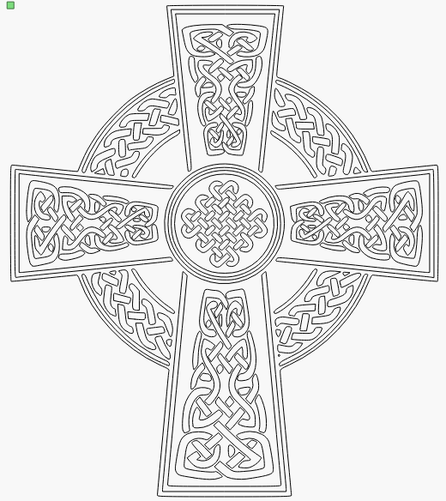



Vector (aka raster) vs Image (aka lines)
.jpg file
612 x 612 pixels
Vector tracing of the same image
Composed of rows of pixels
Quality of image gets worse with enlargement.
Composed of many lines
Quality of image Stays sharp with enlargement.

Slide 5
Vector Graphics vs Images
VECTOR GRAPHICS:
Definition: Points, lines, curves defined by math.
If you keep zooming in, the lines stay sharp.
Why do we care?
We can enlarge or shrink vector images and not lose image quality.
The laser can be easily guided along these lines to cut through the material.
There are lots of programs that let us create designs we save as vector format.
IMAGES (Raster graphics):
Definition: A group dots (pixels), each with a color , that make up an image.
If you keep zooming in, you eventually see the dots.
Why do we care?
We can burn a picture of “Little Jimmy” on something we make.
Since the laser needs to travel to each pixel location, and fire an amount of energy based on the color of the pixel, it can take a long time to render an image.
We can cut through the material based on a raster image, but it’s tedious and impractical. Like cutting a piece of paper in hole with a hole punch.

Slide 6
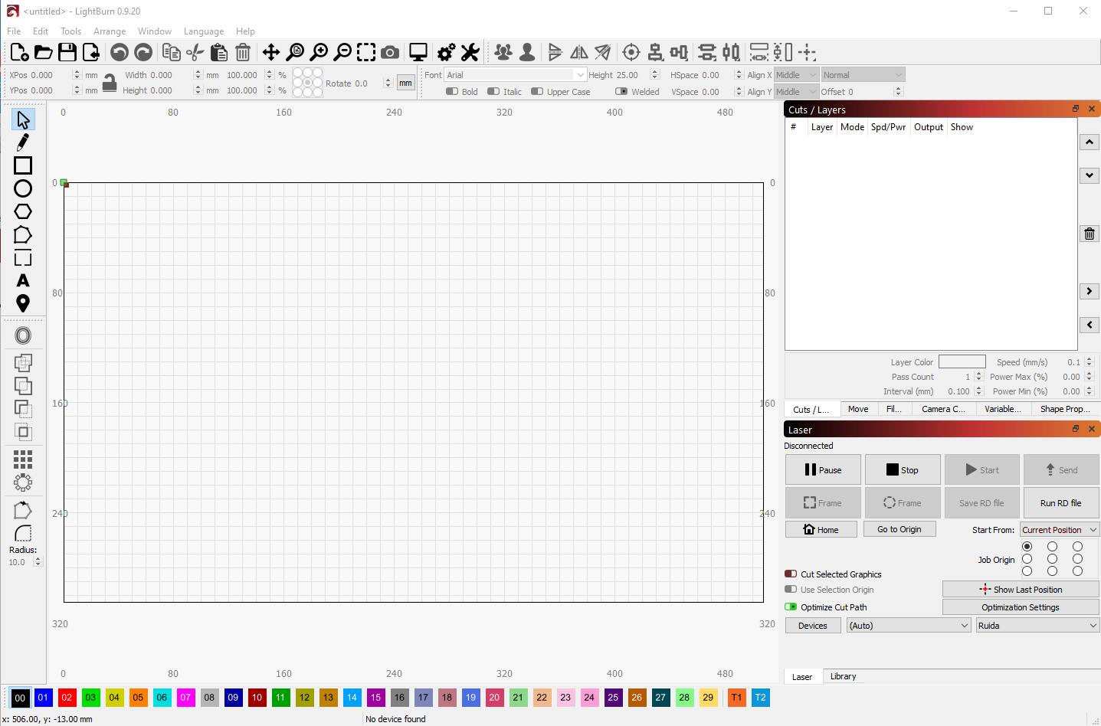
The LightBurn Interface

Slide 7
LightBurn
Main Menu
Settings
Mirror
Undo / Redo
Group
Align and adjust
File
Cut/ Paste
View
Preview
Numeric Edits
Text
Create shapes
Control window
Cuts / Layers
Move (the laser)
Camera Control
Variable Text
Shape Properties
Manipulate
Design Area – It’s the size of the cut area on the machine
Laser Control
Cut Palette - for Layer Assignment

Slide 8
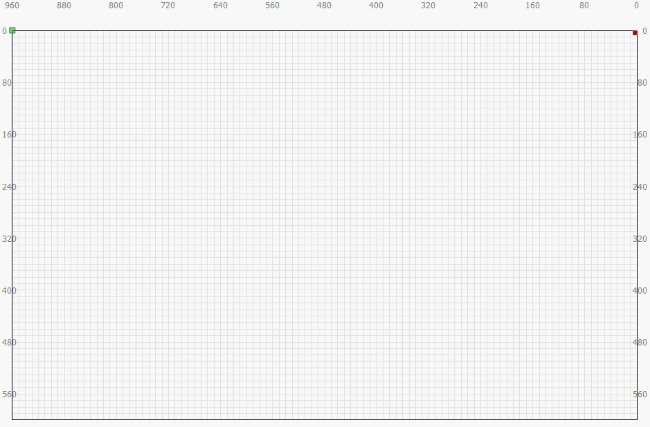
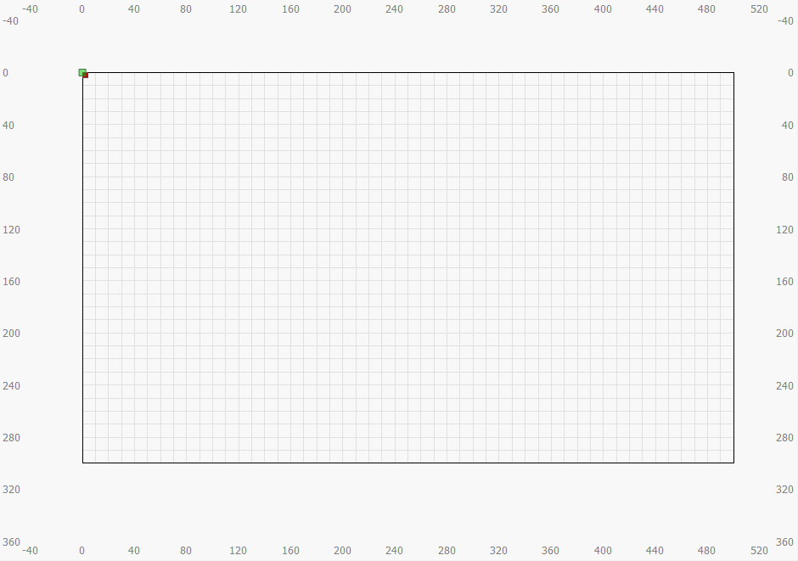
The Design Area
When you start the LightBurn app, it will find the laser connected to it and import parameters associated with it. The important parameters are the size of the design area, and where the origin is (which sets the direction of X and Y).
X increases from right to left
X increases from left to right
The origin is the top-right corner (little red square).
The origin is the top-left corner (little red square).
Design area
960mm wide
600mm tall
Y increases from top to bottom
Design area
500mm wide
300mm tall
Y increases from top to bottom
Big Red
Little Blue

Slide 9
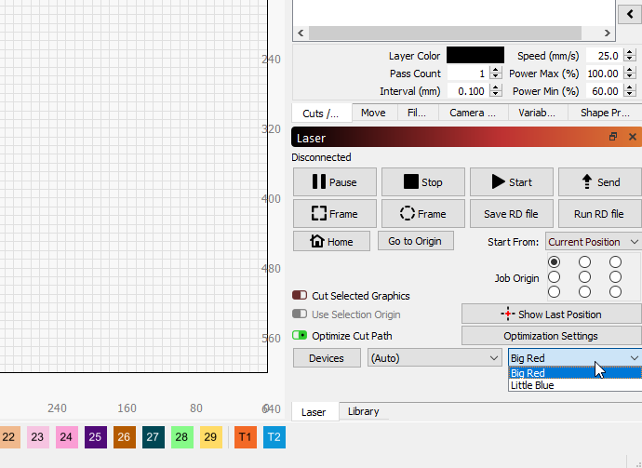
Using the Studio workstations
If you are using a workstation in the main studio (or a personal copy of LightBurn), you should select the device (Little Blue or Big Red) that you plan to use when you go to the laser. Look in the bottom right corner of the Laser window and there is a dropdown with all the devices this copy of LightBurn has set up.
The Laser Window has a drop down for Devices. Pick the one you plan to use.

Slide 10
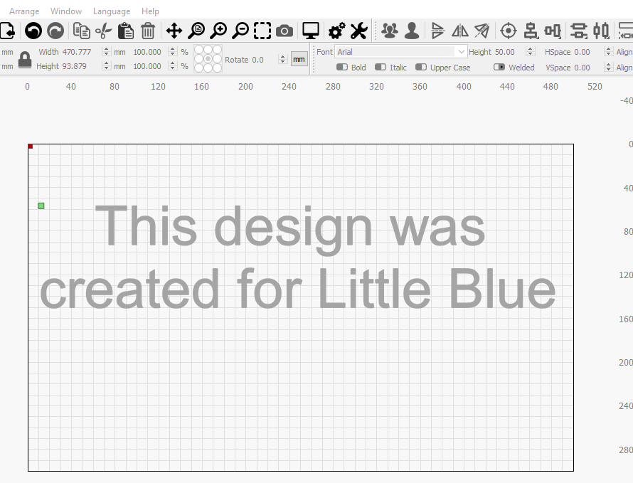
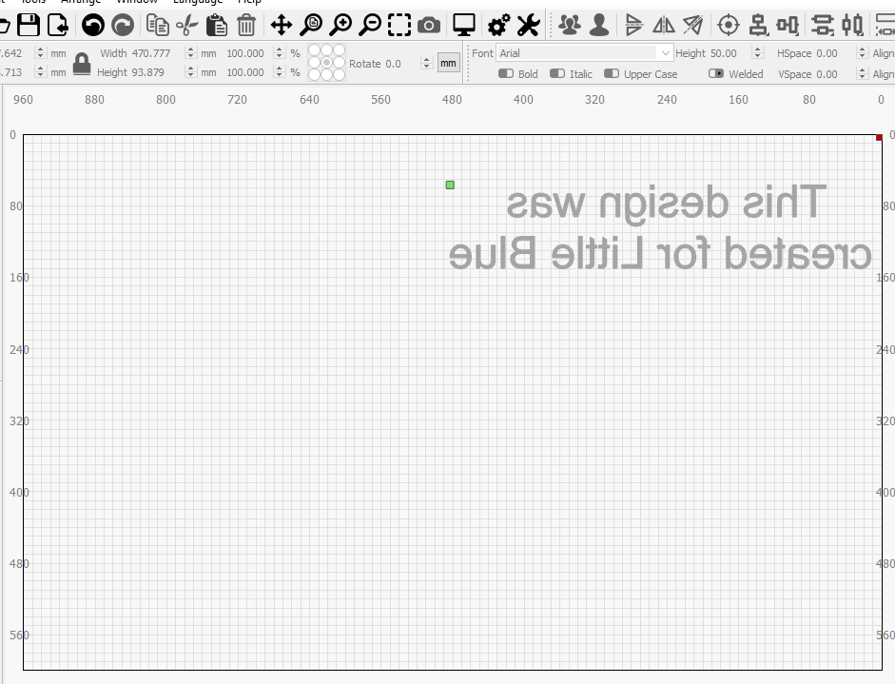
Switching Machines
If you save your design on one machine and then open it on the other, the different directions of the Y axis will cause the design to be mirrored. The fix? Make sure Show is ON for all layers, select all objects and do a horizontal mirror
Horizontal mirror
Little Blue
Big Red

Slide 11
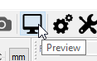
Typical Laser Workflow
Create your design on the SW of your choice
Start LightBurn and select Device
Import your design into LightBurn
Set up the Cutting/Engraving parameters
VECTOR
IMAGE
Preview your job
Group objects for Engraving or cutting
Set order of cuts
Set power and speed
Edit Shape properties to adjust
Set power and speed
AT THE LASER
Adjust laser focus
Little Blue – turn knob
Big Red – monitor assist
Position the material on the cutting grid
Send file to laser
Frame to verify
fit
Close lid, start, and watch
Always monitor the laser, while it’s running
Set power and speed

Slide 12
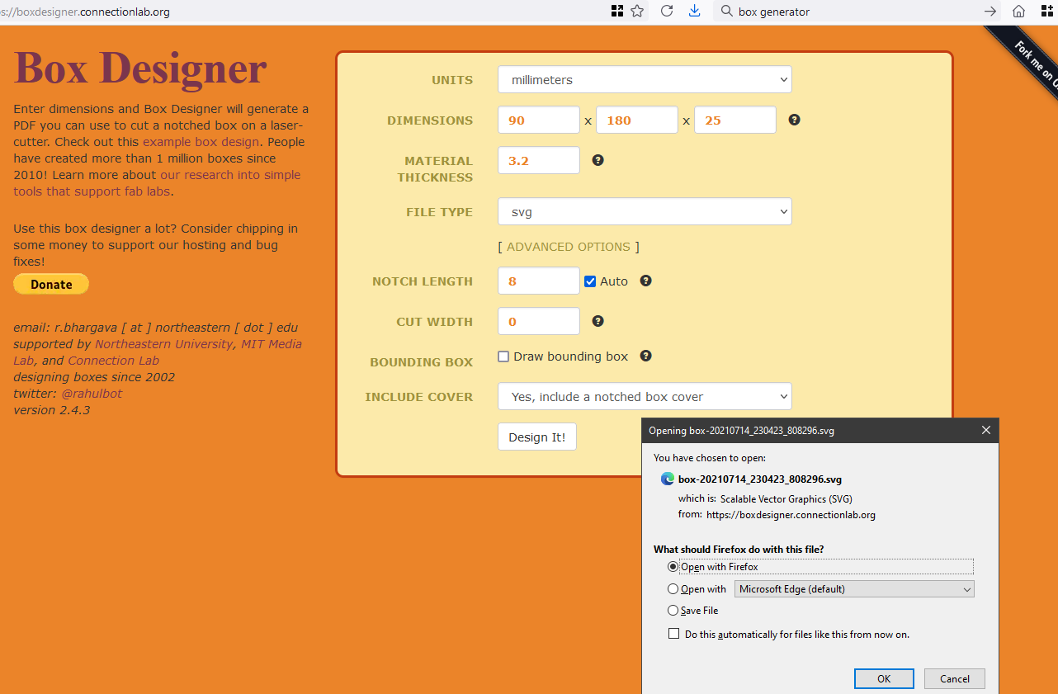
Design - Pencil box from the internet
Lots of box design tool are available on the web.
boxdesigner.connectionlab.org is one.

Slide 13
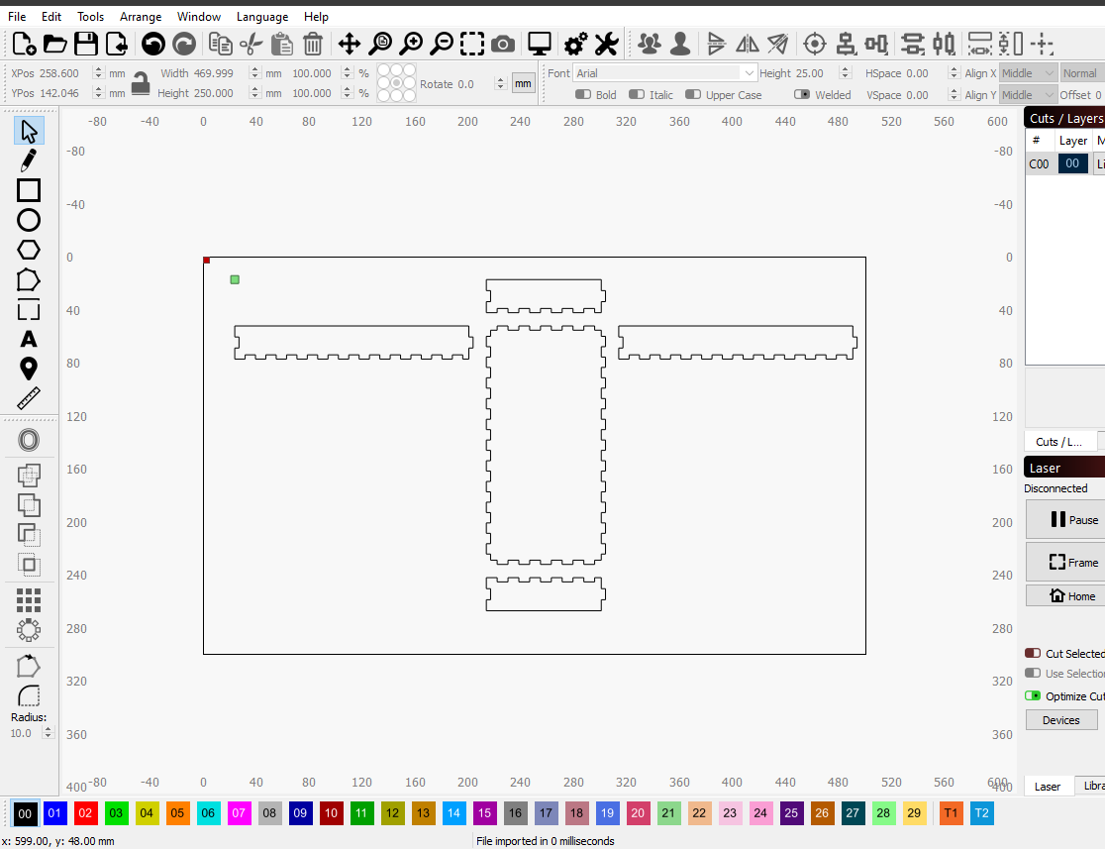
Import your design
1. File Menu
2. Import
3. Select your file
OR
Drag and drop you file onto the design area.

Slide 14
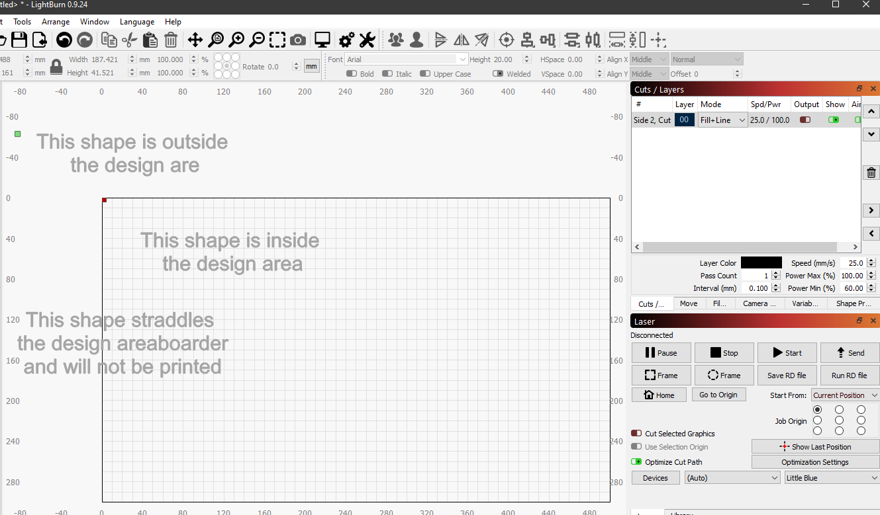
Positioning your design
Objects outside the design area may not be cut, but can drive where the laser tries to start from (green square), even if Output is OFF.
Best to keep all objects inside the design area to avoid unexpected behavior
Objects that straddle the design area will not be “partially cut”
X increases from right to left
X increases from left to right
The origin is the top-right corner (little red square).
The origin is the top-left corner (little red square).
Design area
960mm wide
600mm tall
Y increases from top to bottom
Design area
500mm wide
300mm tall
Y increases from top to bottom
Big Red
Little Blue

Slide 15
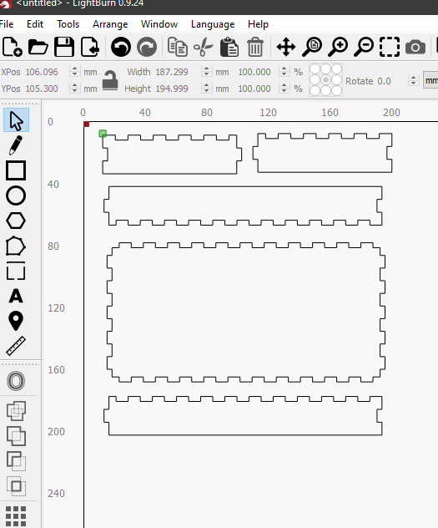
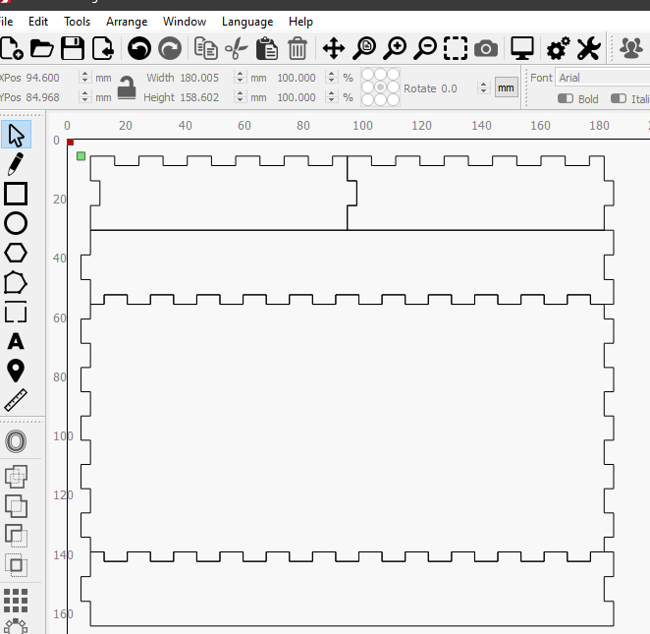
Optimizing design position
Share edges for faster cutting and best material utilization.
Note: If using Big Red, it’s wider cut may make your box joints loose with this method. Assess your need for using “offset”
Ungroup and arrange for better material utilization
X increases from right to left
X increases from left to right
The origin is the top-right corner (little red square).
The origin is the top-left corner (little red square).
Design area
960mm wide
600mm tall
Y increases from top to bottom
Design area
500mm wide
300mm tall
Y increases from top to bottom
Big Red
Little Blue

Slide 16
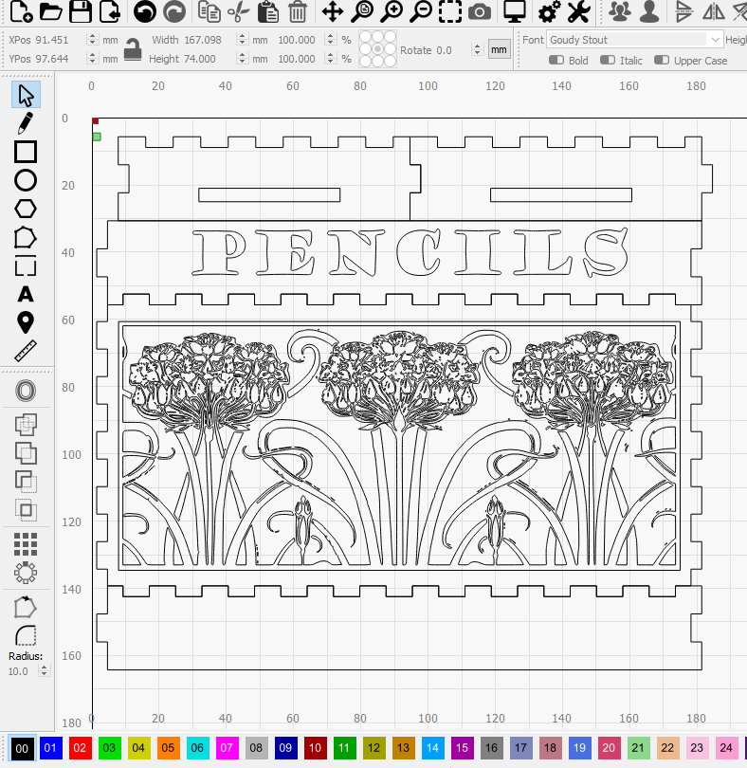
Adding some embellishments
Finger holes
Text
Artwork
The origin is the top-right corner (little red square).
The origin is the top-left corner (little red square).
Design area
960mm wide
600mm tall
Y increases from top to bottom
Design area
500mm wide
300mm tall
Y increases from top to bottom
Big Red
Little Blue

Slide 17
Layers
“Layers” are how we collect things together to set the order of cutting and set different cutting properties.
Outlines and holes are “through cuts”
Artwork might be outlined or filled
Text might be outlined or filled.
To assign a layer to an object:
Select one or more objects .
Select a Layer from the “Layer Palette”.
Which layer you choose does not matter. Pick some that help you see your design.

Slide 18
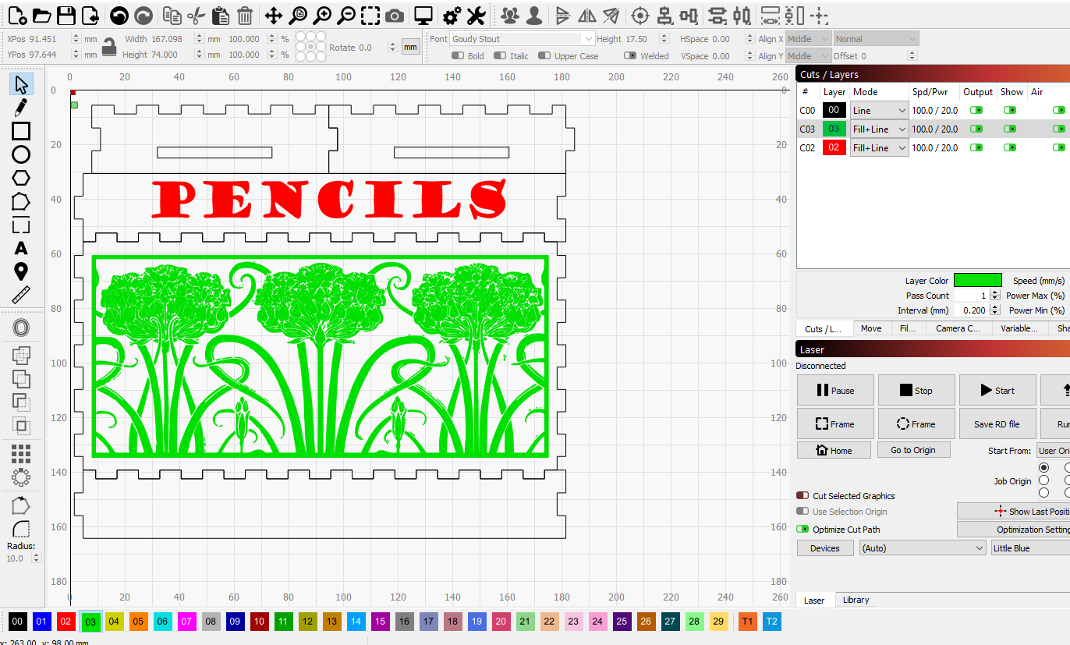
Layers assigned
I left all the through cuts on Layer 00 (Black)
I put the text on Layer 02 (Red). I plan to outline and cross-hatch it
I put the artwork on Layer 03 (Green). I’ll do an outline and solid fill on it
When a layer has been assigned to one ot more objects, it appears in the Cuts/Layers window.

Slide 19
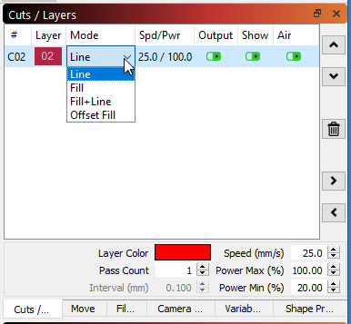
Cuts / Layers Window
Each layer has “Cut Parameters” that control what the laser does with each object on that layer. The order of the layers can (usually does) control the order the objects are cut/etched. The common cut parameters on in the Cuts/Layers window.
Select a “MODE”
Line – follow vectors
Fill – raster fill the object, but no outlines
Fill + Line – do both
Offset fill – spiral fill (vs raster)
Show object on this layer in the design area?
Lase objects on this layer?
Useful for adding notes
If the window is hidden, click on it’s tab
Speed – speed of laser
Power Max - “normal” power
Power Min - minimum power when the laser slows down at a corner.
How many times to repeat this cut – rarely used

Slide 20
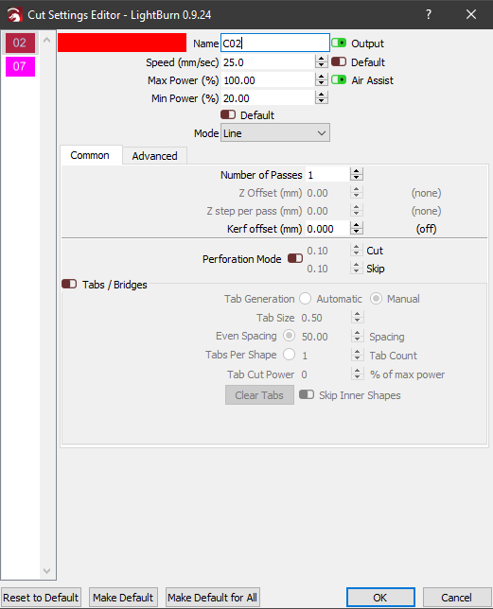
More Cut parameters
Double clicking on a layer in the Cuts/Layers window opens the full set of cut parameters. We’ll only talk about a few here.
Naming your layers helps you keep track of things in your design .
Speed/Power/Mode settings
Offset the cut to account for the laser kerf
Make a dashed cut or etch line.
Please don’t reset the defaults
If these are not enough, there is an Advanced Tab

Slide 21
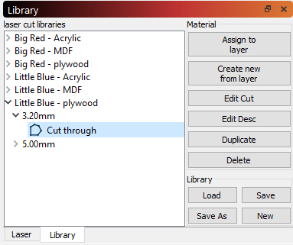
Library Window
We have created a library of cut settings for typical materials. These can be assigned to a layer. It’s a great starting point.
3. Expand material, thickness, and select a named cut
Important – pick for the machine you plan to use
1. Select a layer you want to assign library cut parameters to
4. Click “Assign to Layer” to copy the cut parameters to your current layer
2. Select the Library tab if the library window is not visible. Normally the laser tab is visible.
You can download the LittleBlue, BigRed, and CombinedETA libraries here: https://github.com/BainbridgeArtisanResourceNetwork/LightBurn_Config_Files
After assigning a library cut to your layer, you can modify the cut settings for that layer without affecting the library. - it’s a copy operation, not a linking operation.

Slide 22
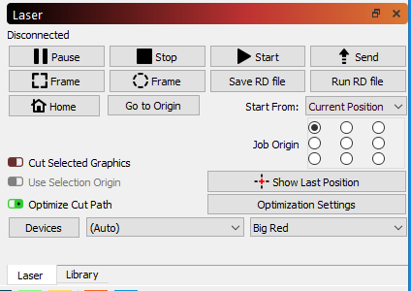
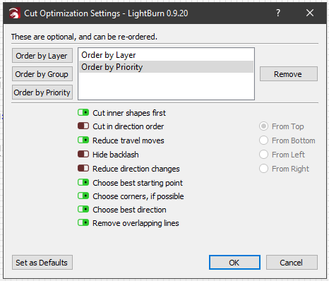
Cutting order Priority and Optimization
To see or change the LightBurn Optimization settings, select the Optimization Settings button
We recommend these settings
Layers first, then priority within Layers
Cutting inner shapes first is good.
Let LightBurn not cut multiple times when shapes share edges.
LightBurn will optimize the cut order if it if you let it. You can turn it off in the Laser Window, but we like it left on.

Slide 23
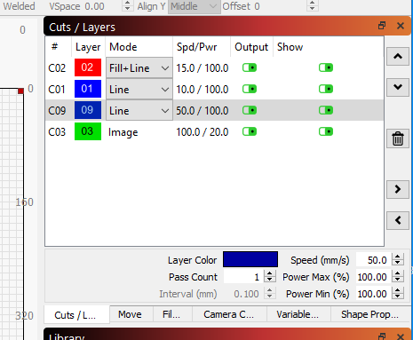
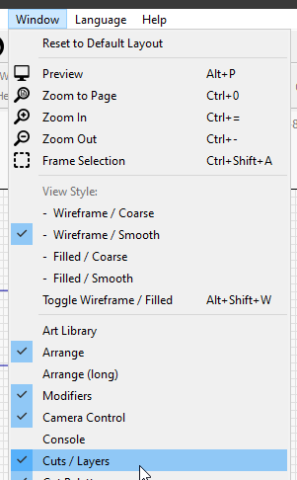
Most used – Order by Layer
Most common - priority by layer order
Move a layer up or down in priority with these arrow buttons
Turning off “Output” means it wont be cut, so its order does not matter.
If the cuts/Layers tab or window is not visible, turn it on from the Window menu

Slide 24
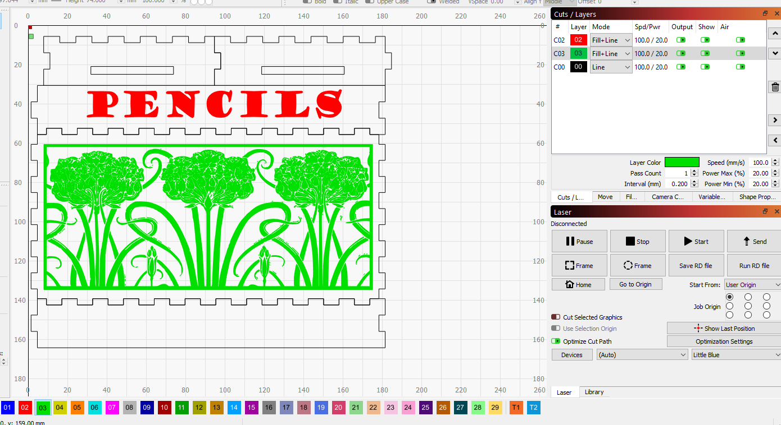
Cut order Planning 1 - layer order
I want the holes in the parts cut before the outlines
I want the artwork and text engraved before the parts are cut out.
I want to cut out the smaller parts first, and the biggest one last
I’ve reordered the layers to reflect my plan. But what about the order of the through-cuts?

Slide 25
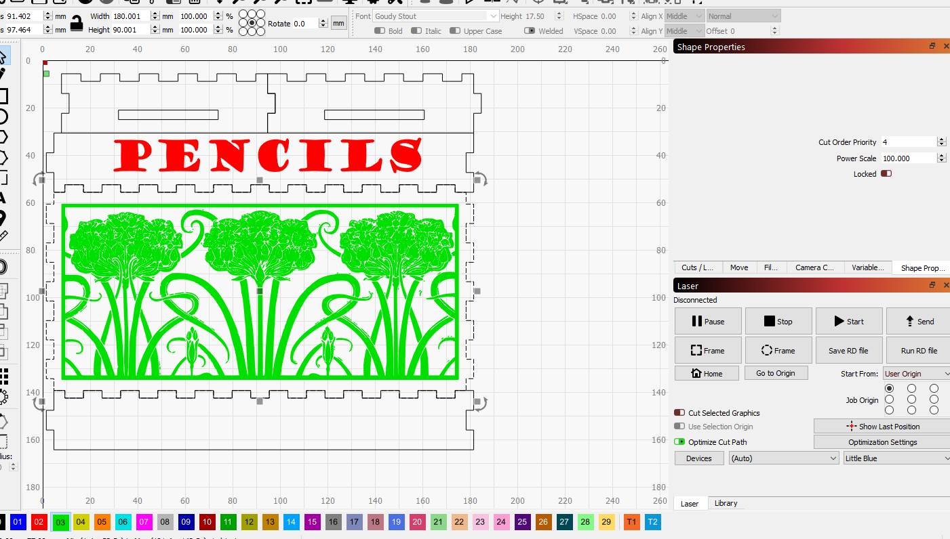
Cut order – Shape priority
Priority 1
Priority 1
Priority 2
I didn’t change the priorities on the artwork because they are each on their own layer.
Priority 4
Priority 3
Each shape can get a priority assigned. IF two shapes have the same priority, LightBurn will pick the order.

Slide 26
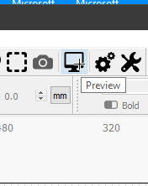
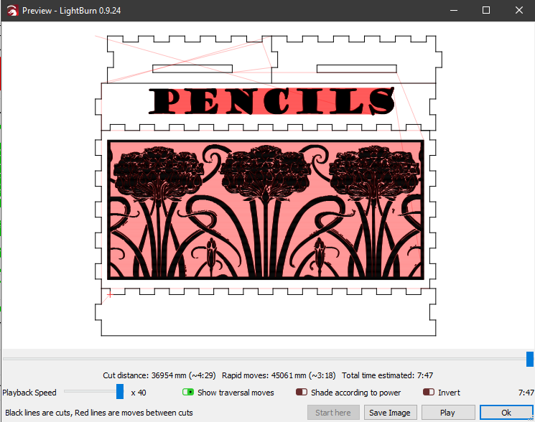
Preview your cutting
Select the Preview icon on the tool bar, or right click on the design space and select Preview.
Black lines are laser-on moves and red are laser-off moves. Selecting Play will animate the job so you can see the order. A time estimate is also provided.

Slide 27
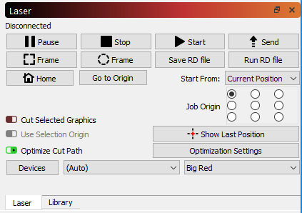
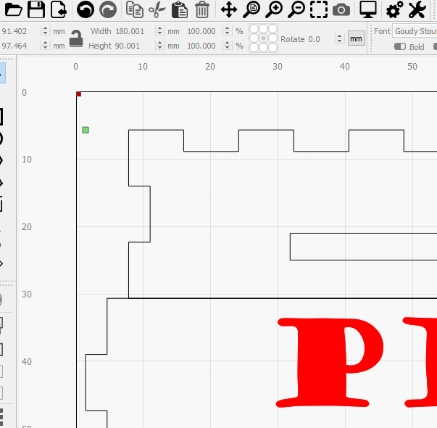
Aligning LightBurn with the laser
You need to tell LightBurn where to start cutting from This is done in the Laser window.
We recommend moving the laser to the back left corner of the material, and the following settings
Start from “Current position” (the place where you just positioned the laser).
Then select the “Job Origin”” to match which corner of the material you moved the laser to.
LightBurn will put a little green square on the design to show where the laser will start.
The Next step (Frame) will tell you if you got everything right.

Slide 28
“Focus” the laser
Place your material on the cutting grid so that it is under the laser cutting head (you might need to move the laser over the top of your material – use the buttons on the laser control panel – you can’t grab the laser and move it like on the old FS laser.
BIG RED
This laser “autofocuses” by moving the material bed up and down. We are still developing procedures that will be sure the laser doesn’t accidentally crash into itself while moving the bed.
SO… Ask a monitor to help you with the focusing step on Big Red.
LITTLE BLUE
This laser focus is adjusted by moving the med up and down (not fussing with the lens like the old FS laser). There is a knob inside the laser – front right corner – that moves the bed up and down.
Move the bed down so your material can be placed under the nozzle.
Move the bed up until the nozzle is 6mm from the surface of your material. There is a piece is 6mm plywood to use as a gauge. The setting in not too fussy. You can see when the nozzle just about touches.

Slide 29
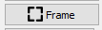
Frame
You can also use the Frame buttons in LIghtBurn
When you click one of the two frame buttons, the laser will move around the outside of the area where the cuts will take place. If the laser traces off your material, something needs to be changed.
The laser traces a rectangle that encloses all the cuts to be made.
The laser traces a “rubber band line” around the shapes it will cut.
After you send your project to the laser and set the origin on the laser control panel, you can use the laser control panel “frame” button to frame you cut.

Slide 30
Working with Images
There are generally two destinations people are pursuing when working with images:
1. Burn a realistic picture onto something.
2. Extract from the image to create something to cut/engrave.
Realistic pictures
Insert your picture.
Scale it up/down to fit your intended size.
Select the image, then Right click the image and select “Adjust Image” from the pop-up menu.
Select the “Image Mode” and adjust as desired. Click OK.
Modify speed/power in the Cuts/Layers menu.
This is a trial/error process. Expect to spend time finding your artistic muse.
Extracting vectors from images
Insert your picture.
Select the image, then Right click the image and select “Trace Image” from the pop-up menu.
Adjust with the sliders until you like it. Click OK.
Move or delete the original image. If not deleted, set “Output” off in Cuts/Layers window.
Scale it up/down to fit your intended size.

Slide 31
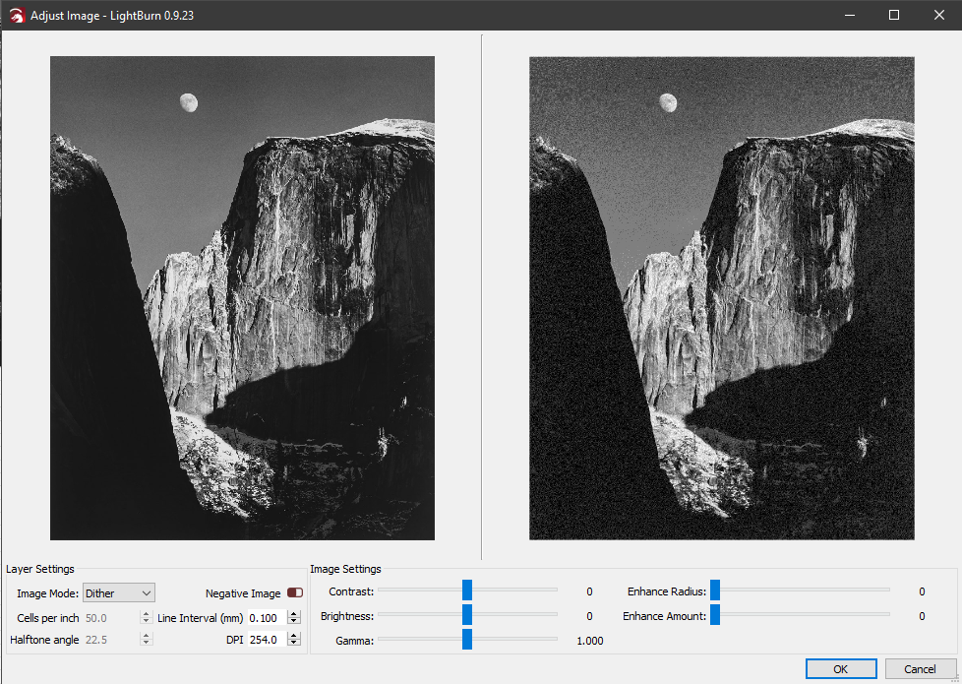
Realistic pictures Image Adjust window
With Image Mode applied
Original Image
Slider bars adjust the original image before the mode filter is applied.
Select Image mode here

Slide 32
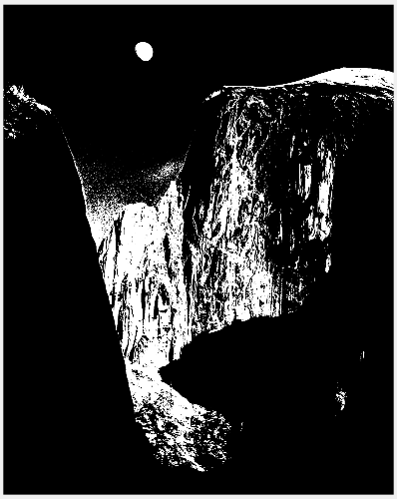
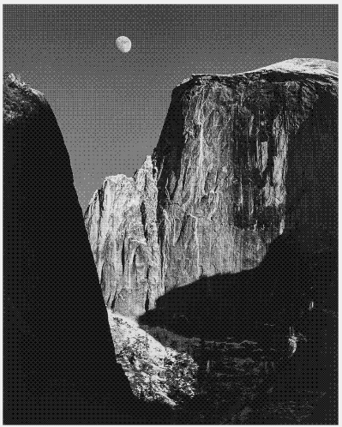
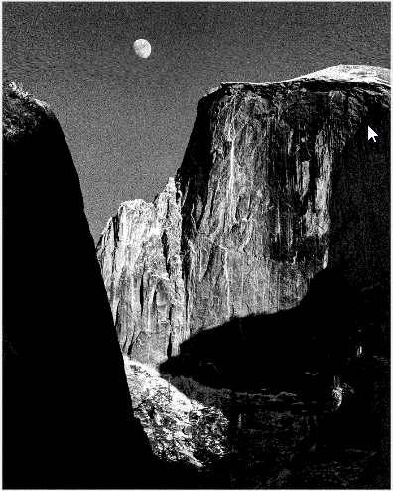
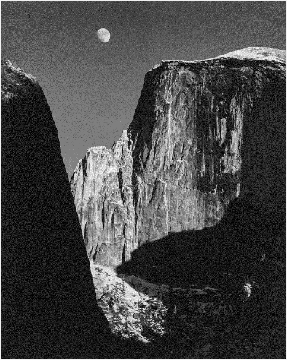

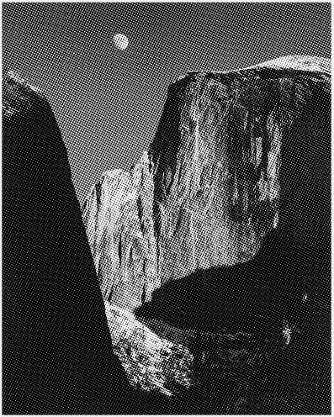
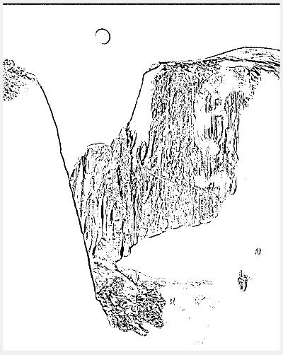

Image adjust filters
Threshold
Ordered
Atkinson
Dither
Newsprint
Halftone
Sketch
Grayscale

Slide 33
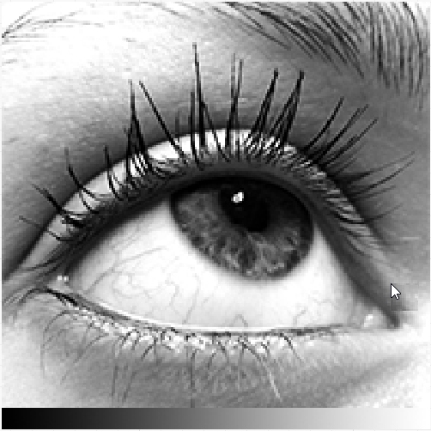
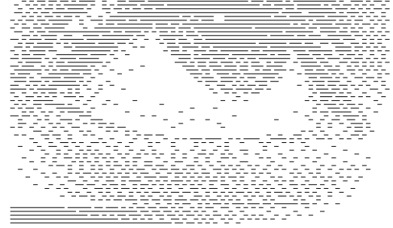
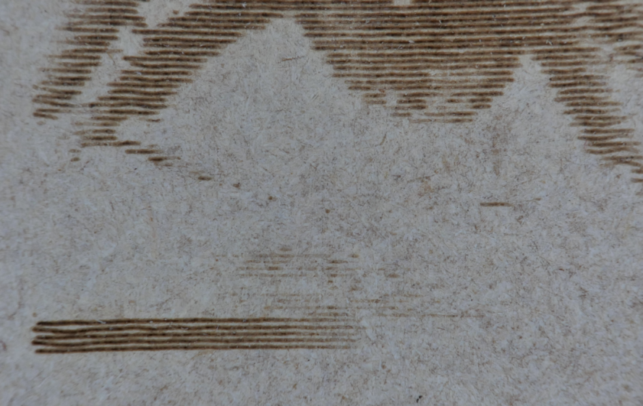
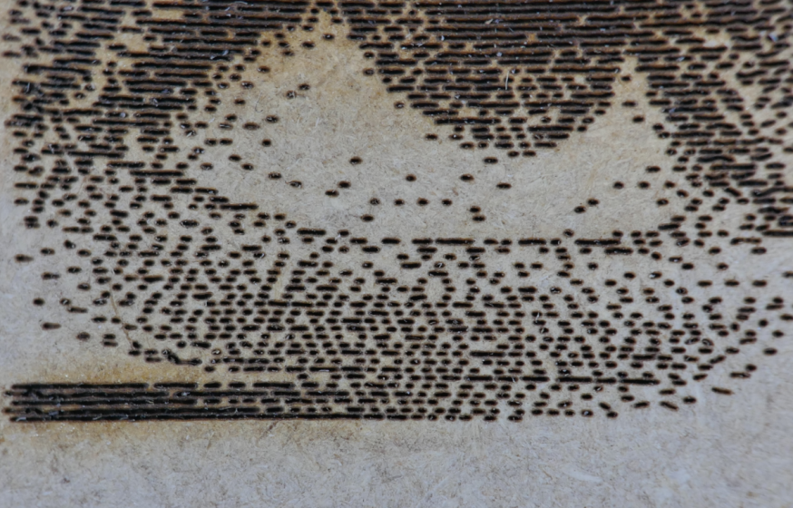
Grayscale vs dithered
Original Image
Preview of Stucki dithering
Close-up of Grayscale laser cut
Close-up of Stucki laser cut

Slide 34
Photo Summary
Expect to spend some time practicing with pictures before getting one you this is “just right”. When you do get there, please share what you’ve learned, maybe teach a class on the subject.
Getting your picture “just right” will likely involve applying filters, and adjusting photo parameters. You can use the LightBurn tools, but you can also pre-process photos in a lot of other applications before you import them to LightBurn, and those apps may have better filters. Don’t be afraid to pre-process your photos.
Other good advice to be added here once we learn it.

Slide 35
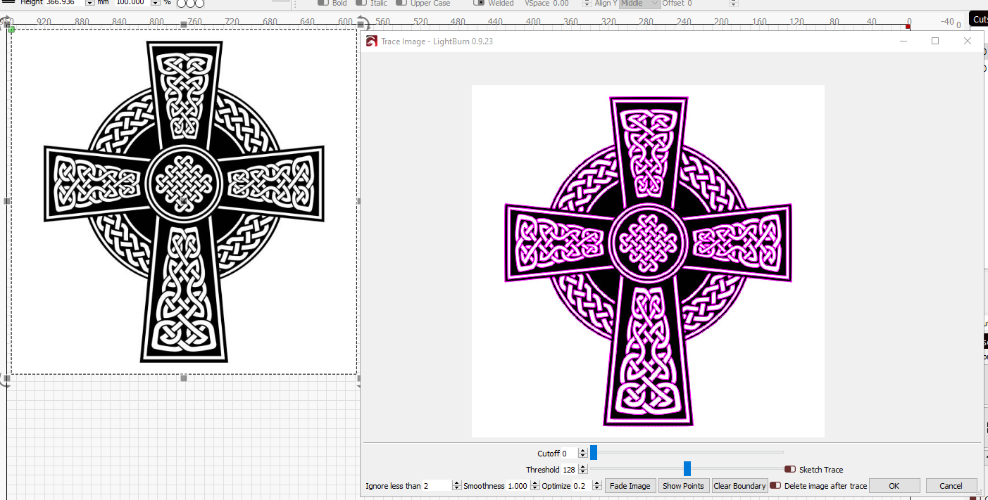
Converting Images to vectors
You can convert images into vectors - this works better with graphics than pictures. After importing your image, left click to select it, then right click and select “Trace Image” in the pop-up menu.
Slider bars adjust how LightBurn finds edges.
Original Image
The traced image is left on top of the original. Move or delete the original to see the vector image

Slide 36
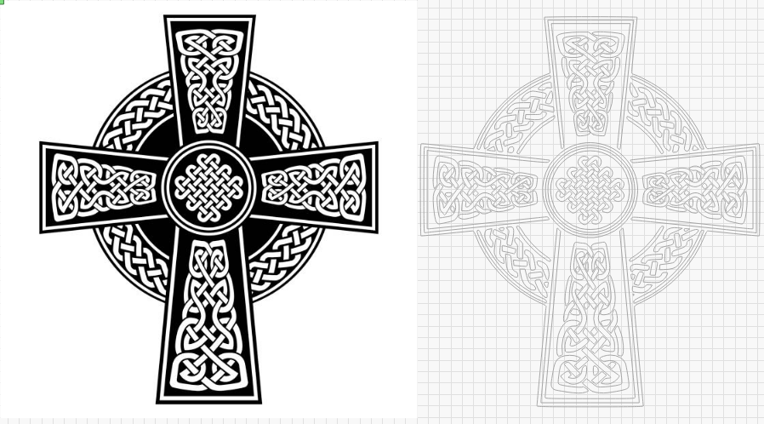
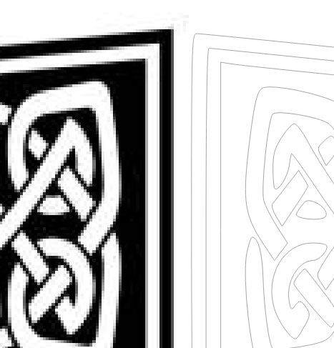
Converting Images to vectors
Original Image
Vector Image
Close up of original image and vector lines.

Slide 37
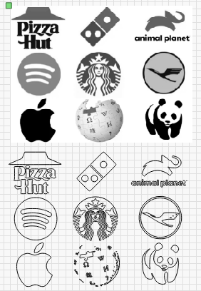
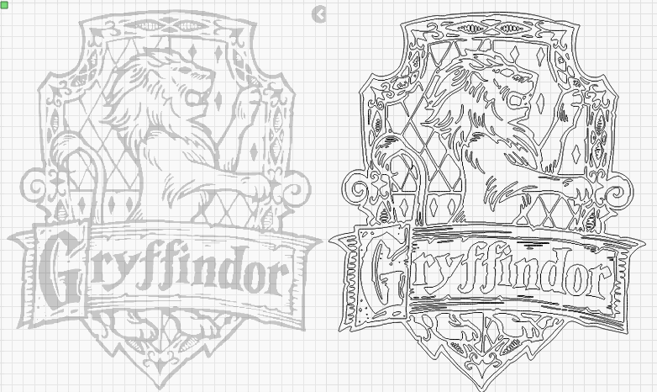
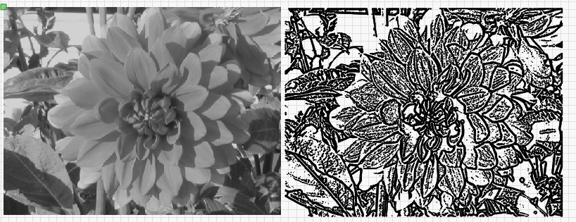
Other examples

Slide 38
Configuring LightBurn

Slide 39
Vector Graphics vs Images
VECTOR GRAPHICS:
Definition: Points, lines, curves defined by math.
If you keep zooming in, the lines stay sharp.
Why do we care?
We can enlarge or shrink vector images and not lose image quality.
The laser can be easily guided along these lines to cut through the material.
There are lots of programs that let us create designs we save as vector format.
IMAGES (Raster graphics):
Definition: A group dots (pixels), each with a color , that make up an image.
If you keep zooming in, you eventually see the dots.
Why do we care?
We can burn a picture of “Little Jimmy” on something we make.
Since the laser needs to travel to each pixel location, and fire an amount of energy based on the color of the pixel, it can take a long time to render an image.
We can cut through the material based on a raster image, but it’s tedious and impractical. Like cutting a piece of paper in hole with a hole punch.

Slide 40
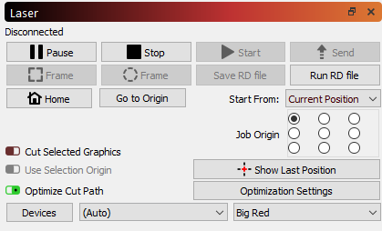
Downloading LightBurn
You can run LightBurn on your own computer. Go to https://lightburnsoftware.com/ and follow the “Download/Trial” link. The software is free for 30days.
Installation – When you first run LightBurn, it wants you to connect it to a Device.
Select “Create Manually”.
Scroll down and select “Ruida” from the controller list, then Select “Next”.
Select “Serial/USB”, then Select Next.
A. Name your printer “Little Blue”, or “Big Red” – or whatever you want. B. enter the X and Y dimensions (X = 500mm, Y = 300mm for little Blue; X = 1000mm, Y=600mm for Big Red). Then Select Next.
Select the button for Laser’s origin. “Rear Right” for Big Red, and “Rear Left” for Little Blue. Then Select Next.
Select Finish. You are ready to go.
You can add another device (or edit the one you created) by clicking on the “devices” button in the Laser window. If you have two or more devices, you can select which to use in this window.
Select “Devices” in the Laser window to add or edit a laser

Slide 41
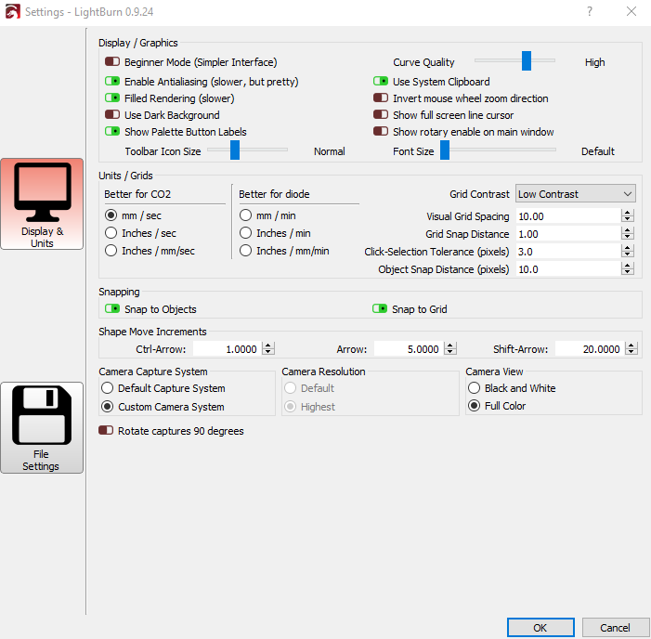
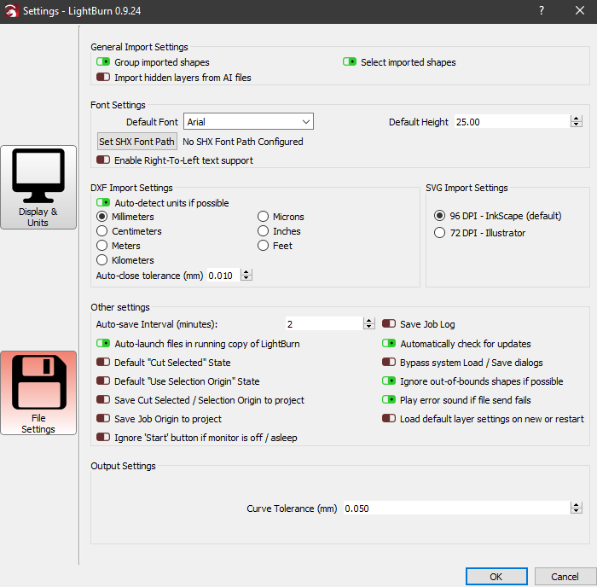
Some user settings to know
Click Edit, then select “Settings” to open the Settings window. There are two sections, Display and Units, and File Settings.
Group shapes on Import
Switch the zoom on the mouse wheel if it seems backwards to you.
Change the units if a DXF is coming in at the wrong scale.
Change the DPI if an SVG is coming in at the wrong scale.

Slide 42
Q&A
Q: Why LightBurn/ what happened to RetinaEngrave
A: LightBurn enables you to access the full features available in the controllers of our new lasers. It’s better than RetinaEngrave and easier to use.
Q: Can I run LightBurn on my own computer?
A: Yes, but you’ll need to buy a license to use it for more than 30 days. One license can be used on up to two computers.
Q: Do I need to do all my project work on the computers conenctd to the lasers?
A: No, LightBurn is also available on the workstations in the ETA studio. It’s best to prep there to give osthers access to the lasers.
Q: Can I still use Inkscape?
A: Yes, but you’ll need to export your project and import into LightBurn to get it onto the laser.

